Slide 1



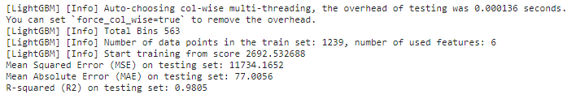
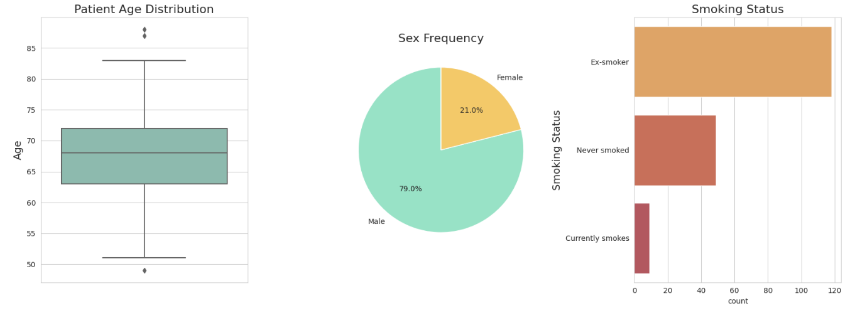
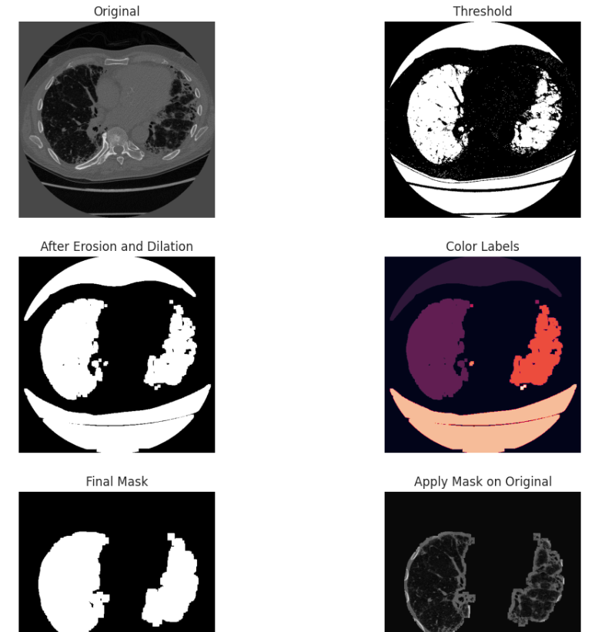
FIBROINSIGHT: AI-ENABLED PULMONARY FIBROSIS PROGNOSIS
Department of Artificial Intelligence and Machine Learning
School of Computing
10214AM602– MINOR PROJECT-2
WINTER SEMESTER 2023-2024
ABSTRACT
INTRODUCTION
RESULTS
STANDARDS AND POLICIES
Pulmonary fibrosis prognosis is a critical lung condition that causes lung scarring, making it harder to breathe. There is no cure that exists for pulmonary fibrosis. The objective is to predict the severity of decline in lung function for patients diagnosed with pulmonary fibrosis based on CT scans, metadata, and baseline Forced Vital Capacity (FVC) measurements. The aim is to develop predictive models for FVC rates, crucial for assessing lung health and oxygen levels. The implementation of machine learning incorporates a theoretical and data-driven strategy to enhance the transit timetable decision-making process. A dataset including FVC measures, patient ID, smoking status is essential to the project code. This project use unsupervised machine learning methods since the data does not have any labels. Gradient Boosting is a popular unsupervised machine learning technique because it combine several weak learners into strong learners hence by reducing loss function such as mean errors. This implements various algorithms including Light Gradient Boosting, Random Forest Regression, Support Vector Machine (SVM) excreta for predicting FVC rate using variable metrics like Mean Square Error (MSE), Mean Average Error (MAE), R^2 , Accuracy and comparing these algorithms to get accurate predictions. Feature engineering techniques are implemented to extract relevant information from medical imaging and clinical metadata.
Lung-related diseases present formidable challenges in diagnosis and treatment due to their complexity and the scarcity of comprehensive data. The absence of definitive cures accentuates the intricate nature of lung functionality, often leading to delayed recognition of conditions like idiopathic fibrosis. Clinicians heavily rely on detailed analyses of CT scans and patient metadata to accurately assess lung health.
In response to these challenges, predictive analytics emerges as a crucial endeavor for healthcare professionals. Predictive models offer invaluable insights, enabling physicians to make more precise assessments of patients' lung health. Leveraging machine learning techniques, particularly in predicting FVC, becomes imperative.
The proposed strategy unfolds in multiple phases. It begins with meticulous data pre-processing and cleansing, followed by exploratory data analysis and Gradient Boosting techniques to comprehend the intricacies of patient data. Stepwise visualizations elucidate the correlations between FVC and various variables like age and smoking status.
Furthermore, the focus shifts to image analysis and metadata scrutiny. Image analysis involves precise delineation of lung images using masks, while metadata analysis utilizes tools like "TQDM," a Python library tailored for such analysis.
Finally, the processed data is utilized to train machine learning algorithms, including Light Gradient Boosting Machine(LGBM), SVM, DenseNet, and ResNet. Each algorithm undergoes rigorous evaluation, with the highest R^2 value considered as the benchmark for predictive efficiency.
Kaggle's standards and policies for the platform are designed to ensure efficient resource allocation, data privacy, and a fair and inclusive environment for all users. Some key aspects of Kaggle's standards and policies include:
GPU4 Platform: For instances created using shapes in the VM.DenseIO.E4 and BM.DenseIO.E4 series, there are reservable memory limits of 32,000 GB and 2,000 total OCPUs
.Resource Limits: Kaggle sets service limits for resources like memory, GPUs, and OCPUs to ensure efficient usage and allocation within the platform.
Data Handling: Kaggle has strict policies and guidelines for handling and protecting user data, including compliance with relevant data privacy regulations (ISO/IEC 27001).
Collaboration and Sharing: Kaggle promotes a collaborative environment where users can share their work, engage in discussions, and learn from each other.
Result of LGBM Machine Learning Model
CONCLUSIONS
Figure 1. Univariate analysis
The project focused on developing a predictive model to assess lung function using FVC as a key measure. It employed advanced data preprocessing, feature engineering, and gradient boosting techniques to enhance model performance, validated through RMSE and MSE. The model's reliability in predicting lung function was demonstrated, ensuring robustness with rigorous testing and validation procedures for generalizability across datasets. This model offers promise for clinical applications, providing a tool to monitor lung function in pulmonary fibrosis patients, with potential for further research expansion to optimize performance. Collaboration with healthcare professionals is crucial for integrating the model into medical systems, enhancing patient care and clinical decision-making in respiratory medicine.
METHODOLOGIES
The AI-enabled pulmonary fibrosis progression project involves data collection from the OSIC Pulmonary Fibrosis Progression dataset, focusing on clinical records and patient demographics. After data preprocessing, which includes handling missing values and one-hot encoding categorical variables, exploratory data analysis (EDA) is used to identify trends and outliers. This process helps in feature selection, where the most relevant attributes are chosen based on their correlation with FVC.The key methodology involves training a predictive model using LightGBM. The model is trained on a subset of the preprocessed data, with hyperparameter tuning and cross-validation to ensure robustness. The model's performance is evaluated with metrics like R² and RMSE, with LightGBM compared to other algorithms, including Random Forest and SVM, to ensure optimal accuracy. The final predictive model is integrated into clinical workflows, providing valuable insights to healthcare professionals for patient care and early intervention. Continuous feedback and iteration maintain the model's effectiveness over time.
TEAM MEMBER DETAILS
A. N. P. SRI CHARITH
(VTU19917)
M V SAI KUMAR
(VTU19945)
U SRIKANTHREDDY
(VTU20364)
ACKNOWLEDGEMENT
Project Supervisor : Dr. V. Jeevanatham Associate Professor
Project supervisor Contact No : +91 96291 94212
Project supervisor Mail ID: drJeevanathamv@veltech.edu.in
Figure 2. Applied mask on CT images.

